Slide 1
Classification Model
Classification: Basic Concepts
Rule-Based Classification
Decision Tree Induction
Bayes Classification Methods
kNN Classifier
Performance Evaluation
Ensemble Classification
Summary
1
Notes:
1

Slide 2
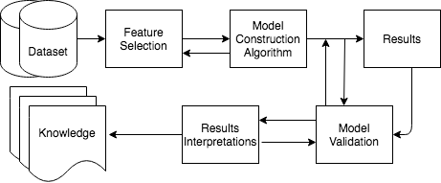
Basic Steps of Data Analysis
Notes:
2

Slide 3
Bayesian Classifier

Slide 4
Bayes’ Theorem
Theorem: If be a given set of n pairwise mutually exclusive events, one of which certainly occurs, i.e.,
and , then for any arbitrary event X,
(i)
(ii) Bayes’ theorem: if P(X) ≠ 0,
Proof: For any event X, we have X=SX= =
Since,
Therefore, are pairwise mutually exclusive events, and hence
[Addition Rule]
Since, [Multiplication Rule]
Therefore, [(i) is proved]

Slide 5
Bayes’ Theorem
We have already proved that
Now we have to prove the Bayes’ theorem: i.e., if P(X) ≠ 0,
Proof: [Multiplication Rule]
Also, [Multiplication Rule]
Hence, if P(X) ≠ 0,
Thus the Bayes’ theorem is proved.

Slide 6
Example on Bayes’ Theorem
Example-1: There are three identical urns containing white and black balls. The first urn contains 2 white and 3 black balls, the second urn 3 white and 5 black balls, and the third urn 5 white and 2 black balls. An urn is chosen at random, and a ball is drawn from it. If the ball drawn is white, what is the probability that the second urn is chosen?
Solution: ?

Slide 7
Example on Bayes’ Theorem
Example-1: There are three identical urns containing white and black balls. The first urn contains 2 white and 3 black balls, the second urn 3 white and 5 black balls, and the third urn 5 white and 2 black balls. An urn is chosen at random, and a ball is drawn from it. If the ball drawn is white, what is the probability that the second urn is chosen?
Solution:
Let A₁= the event that the ball is drawn from the first urn, A₂= the event that the ball is drawn from the second urn, and A₃= the event that the ball is drawn from the third urn.
The events A₁, A₂, and A₃ are pairwise mutually exclusive, and one of these necessarily occurs.
P(A₁) is the probability that 1st urn is chosen, and so on. So, P(A₁)=P(A₂)=P(A₃)=1/3
Let X=the event that ball drawn is white. So, P(X/A₁)=2/5, P(X/A₂)=3/8, P(X/A₃)=5/7.
We have to compute P(A₂/X)

Slide 8
Example-1 Cont… Compute P(A₂/X)
P(X)=P(A₁)P(X/A₁) + P(A₂)P(X/A₂)+P(A₃)P(X/A₃)
=(1/3)(2/5)+ (1/3)(3/8)+ (1/3)(5/7)
=(1/3)[2/5+3/8+5/7]
=(1/3)(417/280) = 139/280
So, By Bayes’ theorem:
P(A₂/X) = [P(X/A₂) P(A₂)]/ P(X)
= [(3/8)(1/3)] / (139/280)
=35/139 (Ans.)

Slide 9

Example-2: LAPLACE’S URN PROBLEM
There are (N+1) identical urns marked 0,1,2,…,N, each of which contains N white and black balls. The i-th urn contains i black and N-i white balls (i=0,1,2,…,N). An urn is chosen at random, and n random drawings are made from it, the ball drawn being always replaced. If all the n balls turn out to be black, what is the probability that the next ball drawn will also be black?
Solution:
Let =the event that the i-th urn is chosen. So, the events
are pairwise mutually exclusive, one of which certainly occurs. Obviously, , for i=0,1,2,…,N.

Slide 10




Example-2 Cont..: LAPLACE’S URN PROBLEM
Let X = the event that all n balls drawn are black. So,
…….(1)
Let Y=the event that (n+1)th ball drawn is black. The XY=the event that all the n+1 balls drawn are black. So, replacing n by n+1 in (1), we get :
Hence the required probability is:
………(2)

Slide 11
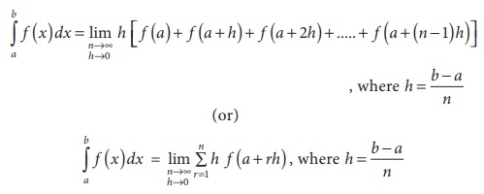

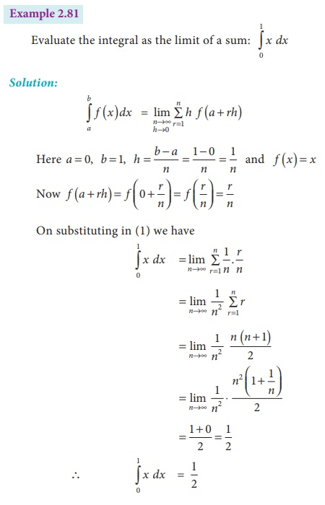


Example-2 Cont..: LAPLACE’S URN PROBLEM
If N is very large: In this case,
Therefore,
This is called the law of succession
of Laplace.

Slide 12
Naïve Bayesian Classification
A statistical classifier: performs probabilistic prediction, i.e., predicts class membership probabilities
Foundation: Based on Bayes’ Theorem.
Performance: A simple Bayesian classifier, naïve Bayesian classifier, has comparable performance with decision tree and selected neural network classifiers

Slide 13
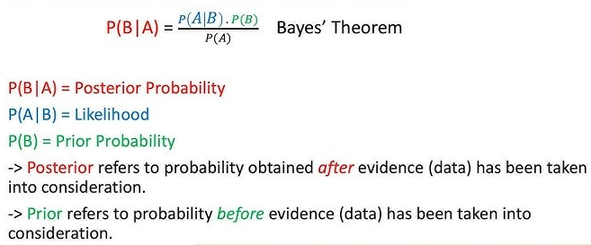
Bayesian Classification

Slide 14
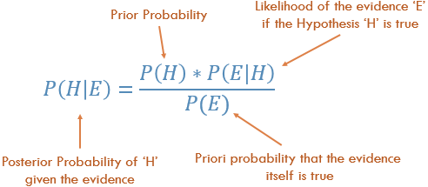
Bayesian Classification

Slide 15
Bayes’ Theorem: Basics
Bayes’ Theorem:
Let X be a data sample: class label is unknown
Let H be a hypothesis that X belongs to class C
Classification is to determine P(H|X), (i.e., posteriori probability): the probability that the hypothesis holds given the observed data sample X
P(H) (prior probability): the initial probability
E.g., X will buy computer, regardless of age, income, student, credit_rating.
P(X): probability that sample data is observed
P(X|H) : the probability of observing the sample X, given that the hypothesis holds
E.g., Given that X will buy computer, the prob. that X is 31..40, medium income

Slide 16
Prediction Based on Bayes’ Theorem
Given training data X, posteriori probability of a hypothesis H, P(H|X), follows the Bayes’ theorem
Predicts X belongs to C_{i} iff the probability P(C_{i}|X) is the highest among all the P(C_{k}|X) for all the k classes
Practical difficulty: It requires initial knowledge of many probabilities, involving significant computational cost

Slide 17
Classification Is to Derive the Maximum Posteriori
Let D be a training set of tuples and their associated class labels, and each tuple is represented by an n-D attribute vector X = (x₁, x₂, …, x_{n})
Suppose there are m classes C₁, C₂, …, C_{m}.
Classification is to derive the maximum posteriori, i.e., the maximal P(C_{i}|X)
This can be derived from Bayes’ theorem
Since P(X) is constant for all classes, so only
needs to be maximized

Slide 18
Naïve Bayes Classifier
A simplified assumption: attributes are conditionally independent (i.e., no dependence relation between attributes):
This greatly reduces the computation cost: Only counts the class distribution
If A_{k} is categorical, P(x_{k}|C_{i}) is the # of tuples in C_{i} having value x_{k} for A_{k} divided by |C_{i, D}| (# of tuples of C_{i} in D)
If A_{k} is continous-valued, P(x_{k}|C_{i}) is usually computed based on Gaussian distribution with a mean μ and standard deviation σ
and P(x_{k}|C_{i}) =

Slide 19
Naïve Bayes Classifier: Training Dataset
Class:
C1:buys_computer = ‘yes’
C2:buys_computer = ‘no’
Data to be classified:
X = (age <=30,
Income = medium,
Student = yes
Credit_rating = Fair)

Slide 20
Naïve Bayes Classifier: An Example
P(C_{i}): P(buys_computer = “yes”) = 9/14 = 0.643
To Compute P(X| buys_computer = “yes”)
- P(age = “<=30” | buys_computer = “yes”) = 2/9 = 0.222
- P(income = “medium” | buys_computer = “yes”) = 4/9 = 0.444
- P(student = “yes” | buys_computer = “yes) = 6/9 = 0.667
- P(credit_rating = “fair” | buys_computer = “yes”) = 6/9 = 0.667
X = (age <= 30 , income = medium, student = yes, credit_rating = fair)
P(X|C_{i}) : P(X|buys_computer = “yes”) = 0.222 x 0.444 x 0.667 x 0.667 = 0.044
P(X|C_{i})*P(C_{i}) : P(X|buys_computer = “yes”) * P(buys_computer = “yes”) = 0.028

Slide 21
Naïve Bayes Classifier: An Example
P(C_{i}): P(buys_computer = “no”) = 5/14= 0.357
To Compute P(X|buys_computer = “no”)
- P(age = “<= 30” | buys_computer = “no”) = 3/5 = 0.6
- P(income = “medium” | buys_computer = “no”) = 2/5 = 0.4
- P(student = “yes” | buys_computer = “no”) = 1/5 = 0.2
- P(credit_rating = “fair” | buys_computer = “no”) = 2/5 = 0.4
X = (age <= 30 , income = medium, student = yes, credit_rating = fair)
P(X|C_{i}) : P(X|buys_computer = “no”)
= 0.6 x 0.4 x 0.2 x 0.4 = 0.019
P(X|C_{i})*P(C_{i}) : P(X|buys_computer = “no”) * P(buys_computer = “no”)
= 0.007
P(X|C_{i})*P(C_{i}) : P(X|buys_computer = “yes”) * P(buys_computer = “yes”) = 0.028
P(X|C_{i})*P(C_{i}) : P(X|buys_computer = “no”) * P(buys_computer = “no”) = 0.007
Therefore, X belongs to class (“buys_computer = yes”)

Slide 22
Naïve Bayes Classifier: Comments
Advantages
Easy to implement
Good results obtained in most of the cases
Disadvantages
Assumption: class conditional independence, therefore loss of accuracy
Practically, dependencies exist among variables
E.g., hospitals: patients=> Profile: age, family history, etc.
Symptoms: fever, cough etc., Disease: lung cancer, diabetes, etc.
Dependencies among these cannot be modeled by Naïve Bayes Classifier
How to deal with these dependencies? Bayesian Belief Networks

Slide 23
Overfitting in Naïve Bayes Classification
Naïve Bayes can suffer from overfitting, although it is generally less prone to it compared to more complex models. Overfitting in Naïve Bayes can happen in the following cases:
1. When the Training Data is Noisy or Small
If the dataset is small, the estimated probabilities may not generalize well to new data.
The model might assign very high or very low probabilities to certain features, making predictions too rigid.
2. When Features are Strongly Correlated
Naïve Bayes assumes independence between features, which is often unrealistic.
If features are highly correlated, the model might double-count information, leading to biased probability estimations and poor generalization.

Slide 24
Overfitting in Naïve Bayes Classification
3. When Using Maximum Likelihood Estimation (MLE)
If a class-feature combination does not appear in the training set, Naïve Bayes assigns it a zero probability.
This makes the classifier overfit by being overly confident about observed data and failing on unseen examples.

Slide 25

Resolve Overfitting in Naïve Bayes
1. Avoiding the Zero-Probability Problem
Naïve Bayesian prediction requires each conditional prob. be non-zero. Otherwise, the predicted prob. will be zero.
Use Smoothing (Laplace / Additive Smoothing)
Prevents zero probabilities by adding a small value (e.g., 1) to all counts.
Formula for Laplace Smoothing
where: α is a smoothing parameter (typically 1), and ∣V| is the vocabulary size.

Slide 26
Resolve Overfitting in Naïve Bayes
Avoiding the Zero-Probability Problem
Ex. Suppose a dataset with 1000 tuples, income=low (990), income= medium (0), and income = high (10)
Use Laplacian correction (or Laplacian estimator)
Adding 1 to each case
Prob(income = low) = 991/1003
Prob(income = medium) = 1/1003
Prob(income = high) = 11/1003
The “corrected” prob. estimates are close to their “uncorrected” counterparts

Slide 27
Resolve Overfitting in Naïve Bayes
2. Feature Selection / Dimensionality Reduction
Remove redundant or highly correlated features to better align with the Naïve Bayes independence assumption.
Use PCA, LDA, or Mutual Information to select only relevant features.
3. Use a More Advanced Naïve Bayes Variant
Gaussian Naïve Bayes: If features are continuous, assume they follow a Gaussian distribution.
Multinomial Naïve Bayes: Suitable for text classification.
Bernoulli Naïve Bayes: Best for binary feature representation.

Slide 28
Resolve Overfitting in Naïve Bayes
4. Bayesian Priors
Instead of relying purely on observed data, incorporate prior knowledge to balance probabilities.
Helps when dealing with imbalanced datasets.
5. Cross-Validation
Use k-fold cross-validation to ensure the model generalizes well across different training sets.
Helps in choosing the best smoothing parameter (α). (How?)

Slide 29
Cross-validation for tuning α
K-fold cross-validation helps in selecting the best smoothing parameter (α) for Laplacian smoothing in Naïve Bayes classification
It systematically evaluates different values of α on multiple training and validation sets, ensuring optimal performance.
In Laplacian Smoothing, α > 0 prevents zero probability. The effectiveness of smoothing depends on the choice of α. Too small α can lead to underfitting, while too large α can cause over-smoothing.

Slide 30
Cross-validation for tuning α
K-fold cross-validation helps determine the best α as follows:
1. Divide Data into K-Folds
The dataset is split into K subsets (folds).
The model is trained on K−1 folds and validated on the remaining fold.
This process is repeated K times, with each fold serving as validation once.

Slide 31
Cross-validation for tuning α
2. Test Multiple Values of α
Train the Naïve Bayes model using different values of α (e.g., 0.1, 0.5, 1, 10).
Compute performance metrics (accuracy, log-likelihood, F1-score) on the validation fold.
3. Average Performance Across Folds
The performance of each α is averaged over all K iterations.
This ensures that results are not biased by any specific data split.
4. Select the Best α
The α yielding the highest average validation performance is chosen as the optimal smoothing parameter.
This optimally balances generalization and model accuracy.

Slide 32
Cross-validation for tuning α
K-fold cross-validation helps in fine-tuning the Laplacian smoothing parameter α by systematically evaluating different values and selecting the one that minimizes classification error.
This improves the generalization ability of the Naïve Bayes classifier, ensuring it handles unseen data effectively.

Slide 33
kNN Algorithm

Slide 34
kNN Classifier
k-nearest neighbours (kNN) algorithm as a type of supervised algorithm which can be used for both classification as well as regression predictive problems.
There are three categories of learning algorithms:
i) Lazy learning algorithm: kNN is a lazy learning algorithm because it does not have a specialized training phase or model and uses all the data for training while classification
ii) Non-parametric learning algorithm: kNN is also a non-parametric learning algorithm because it does not assume about the distribution of the underlying data (as opposed to other algorithms such as Gaussian Mixture Model (GMM), which assume a Gaussian distribution about the data
iii) Eager learning algorithm: Eager learners, when given a set of training tuples, will construct a generalization model before receiving new (e.g., test) tuples to classify.

Slide 35
kNN Classifier
The kNN algorithm begins with a training dataset made up of examples that are classified into several categories.
Assume that we have a test dataset containing unlabeled examples that otherwise have the same features as the training data.
For each example (i.e., record) in the test dataset, kNN identifies k examples in the training data that are the "nearest" in similarity, where k is an integer specified in advance.
The unlabeled test instance is assigned the class of the majority of the k nearest neighbors.

Slide 36
KNN: Classification Approach
Locating the unlabeled instance’s nearest neighbors requires a distance function, or a formula that measures the similarity between two instances.
There are many different ways to calculate distance. Traditionally, the kNN algorithm uses Euclidean distance.
The K-NN algorithm works by finding the K nearest neighbors to a given data point based on a distance metric, such as Euclidean distance.
The class or value of the data point is then determined by the majority vote (for classification) or average (for regression) of the K neighbors.

Slide 37
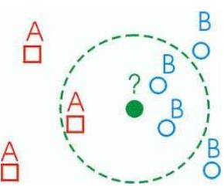
KNN: Classification Approach
Classified by “MAJORITY VOTES” for its neighbor
classes
🞑 Assigned to the most common class amongst its K- nearest neighbors

Slide 38
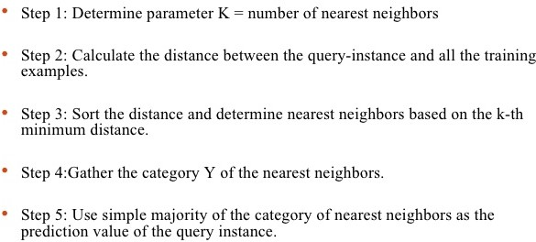
KNN: Pseudocode

Slide 39
Advantages of kNN
kNN algorithm is a versatile and widely used machine learning algorithm that is primarily used for its simplicity and ease of implementation.
It does not require any assumptions about the underlying data distribution.
It can also handle both numerical and categorical data, making it a flexible choice for various types of datasets in classification and regression tasks.
It is a non-parametric method that makes predictions based on the similarity of data points in a given dataset.

Slide 40
Advantages Contd..
K-NN is less sensitive to outliers compared to other algorithms.
Few Hyperparameters – The only parameters which are required in the training of a KNN algorithm are the value of k and the choice of the distance metric which we would like to choose from our evaluation metric.

Slide 41
Disadvantages of the KNN Algorithm
Does not scale – It is a lazy Algorithm. The main significance of this term is that this takes lots of computing power as well as data storage. This makes this algorithm both time-consuming and resource exhausting.
Curse of Dimensionality – The KNN algorithm is affected by the curse of dimensionality which implies the algorithm faces a hard time classifying the data points properly when the dimensionality is too high.
Prone to Overfitting – As the algorithm is affected due to the curse of dimensionality it is prone to the problem of overfitting as well. Hence, generally feature selection as well as dimensionality reduction techniques are applied to deal with this problem.

Slide 42
Why KNN algorithm does not perform well on high-dimensional datasets?
1. Curse of Dimensionality
As the number of dimensions (features) increases, data points become more sparse in the feature space.
The distance between points becomes less meaningful, making it difficult for KNN to find the nearest neighbors effectively.
This leads to poor generalization and degraded performance.
2. Increased Computational Complexity
KNN is a lazy learner, meaning it stores all training samples and computes distances at query time.
In high dimensions, computing distances (e.g., Euclidean distance) becomes computationally expensive.
The time complexity for searching nearest neighbors increases significantly.

Slide 43
Why KNN algorithm does not perform well on high-dimensional datasets?
3. Diminishing Differences in Distances
In high dimensions, the difference between the closest and farthest points reduces significantly.
Most points end up being almost equidistant, making it harder to distinguish between nearest and non-nearest neighbors.
4. Increased Noise Sensitivity
High-dimensional data often contains irrelevant or redundant features.
KNN treats all features equally, meaning noisy or less important features can mislead the distance calculation.
Feature selection or dimensionality reduction (PCA, t-SNE, LDA, etc.) is often needed before applying KNN.

Slide 44
Why KNN algorithm does not perform well on high-dimensional datasets?
5. Memory Overhead
Since KNN stores all training data, a high-dimensional dataset requires more storage and slows down retrieval.
Possible Solutions
1. Dimensionality Reduction: Use PCA, LDA, or feature selection techniques to reduce dimensions before applying KNN.
2. Use Distance Metrics Better Suited for High-Dimensional Data: Cosine similarity or Mahalanobis distance instead of Euclidean distance.
3. Use Approximate Nearest Neighbors (ANN): Faster alternatives like KD-Trees, Ball Trees, or Locality-Sensitive Hashing (LSH) can be used instead of brute-force search.

Slide 45
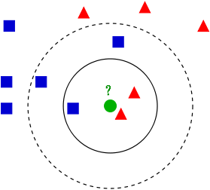
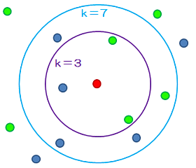
Variation In kNN

Slide 46
How to Choose the value of k?
The value of k is very crucial in the KNN algorithm to define the number of neighbors in the algorithm.
The value of k in the k-nearest neighbors (k-NN) algorithm should be chosen based on the input data. If the input data has more outliers or noise, a higher value of k would be better.
It is recommended to choose an odd value for k to avoid ties in classification.

Slide 47
Value of k
The small k value isn’t suitable for classification.
As a rule of thumb, setting k to the square root of the number of training samples can lead to better result. If k becomes 10 after the square root, we can choose either k=9 or k=11 just to make sure that k is odd.
Use an error plot or accuracy plot to find the most favorable k value.
kNN performs well with multi-label classes, but you must be aware of the outliers.

Slide 48
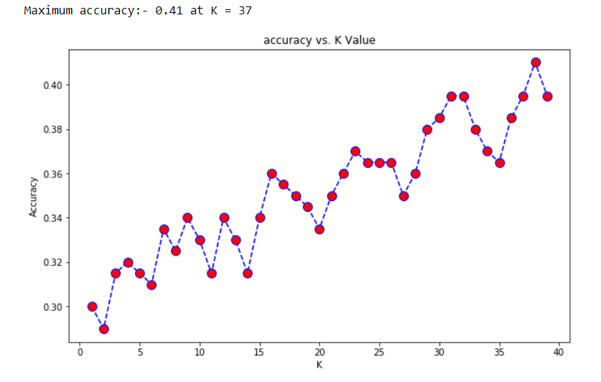
How to Choose the value of k?
We got the accuracy of 0.41 at K=37. As we got the minimum error at k=37, so we will get better efficiency at that K value.

Slide 49
Is Naïve Bayes a lazy learner?
The Naive Bayes algorithm is not a lazy learner. It is an eager learner. It is different from the nearest neighbor algorithm.
A real learning takes place for Naive Bayes. The parameters that are learned in Naive Bayes are the prior probabilities of different classes, as well as the likelihood of different features for each class.
In the test phase, these learned parameters are used to estimate the probability of each class for the given sample.
In other words, in Naive Bayes, for each sample in the test set, the parameters determined during training are used to estimate the probability of that sample belonging to different classes.

Slide 50
Is Naïve Bayes a lazy learner?
For example, P(c|x) ∝ P(c) P(x₁|c) P(x₂|c) ... p(x_{n}|c), where c is a class and x is a test sample.
All quantities P(c) and P(x_{i}|c) are parameters which are determined during training and are used during testing.
This is similar to NN, but the kind of learning and the kind of applying the learned model is different.

Slide 51
THANK YOU

